Slide 1
Advanced Mathematical Finance Module B C++ Week 11
Simon Hartley

Slide 2
Introduction – SYLLABUS
Programming in C++
Class Diagrams
Monte Carlo Options
Black Scholes Options
Binomial Tree Options
Monte Carlo Least Square Means

Slide 3
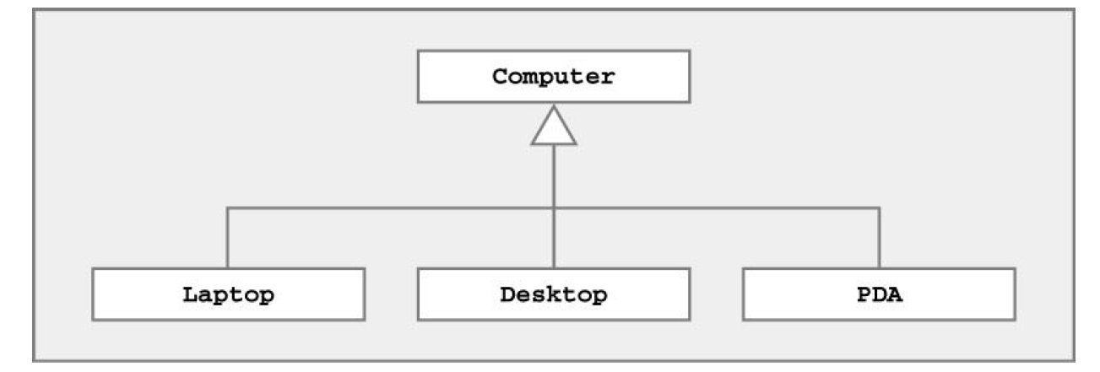
C++ – Class Diagrams
Denotes inheritance between classes
Can view as “is-a” relationship
Represented by line ending in (open) triangle

Slide 4
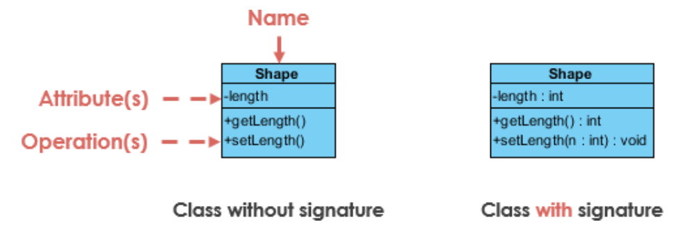
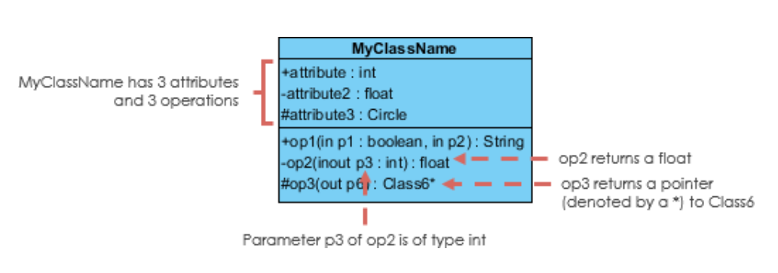
C++ – OOP Class Diagrams
https://www.visual-paradigm.com/guide/uml-unified-modeling-language/uml-class-diagram-tutorial/

Slide 5
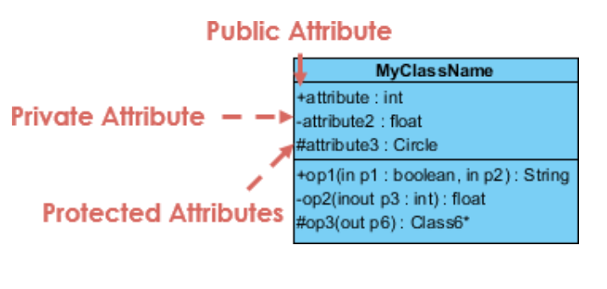
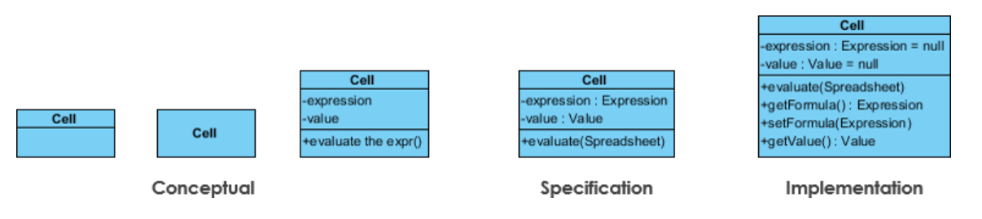
C++ – OOP Class Diagrams
https://www.visual-paradigm.com/guide/uml-unified-modeling-language/uml-class-diagram-tutorial/

Slide 6
C++ – OOP Class Diagrams
Relationships Between Classes
• Association
– Permanent, structural, “has a”
– Solid line (arrowhead optional)
• Aggregation
– Permanent, structural, a whole created from parts
– Solid line with hollow diamond from whole
• Composition
– Whole part relationship (solely owns the part)
– Solid line with solid diamond from whole
• Dependency
–Temporary, “uses a”
– Dotted line with arrowhead
• Generalization
– Inheritance, “is a”
– Solid line with open (triangular) arrowhead
• Implementation
– Dotted line with open (triangular) arrowhead

Slide 7
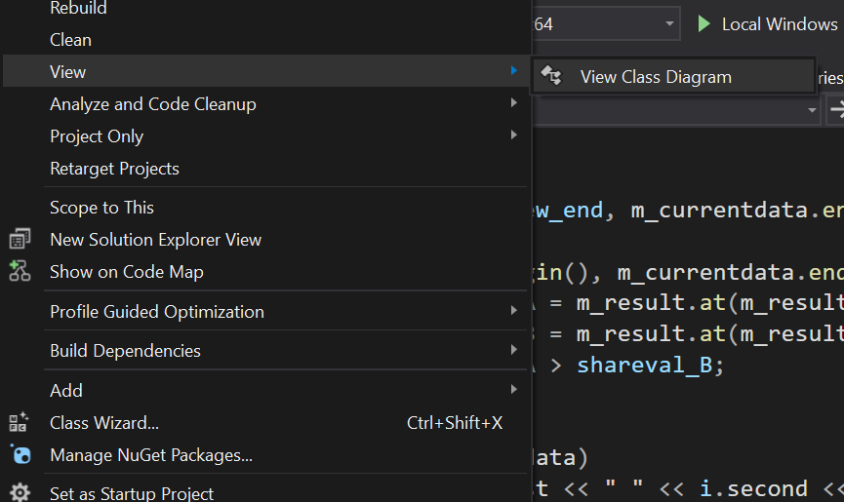
C++ – Class Diagrams
Can be generated automatically
Useful for Documentation

Slide 8
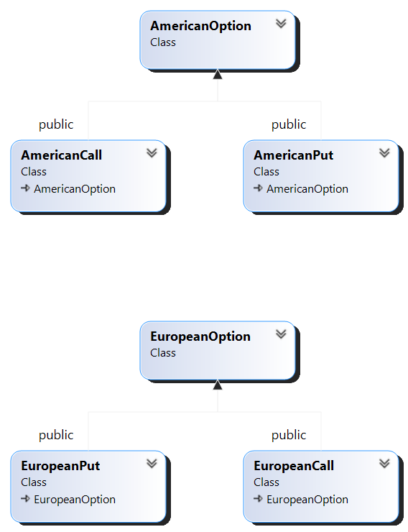
C++ – Class Diagrams

Slide 9
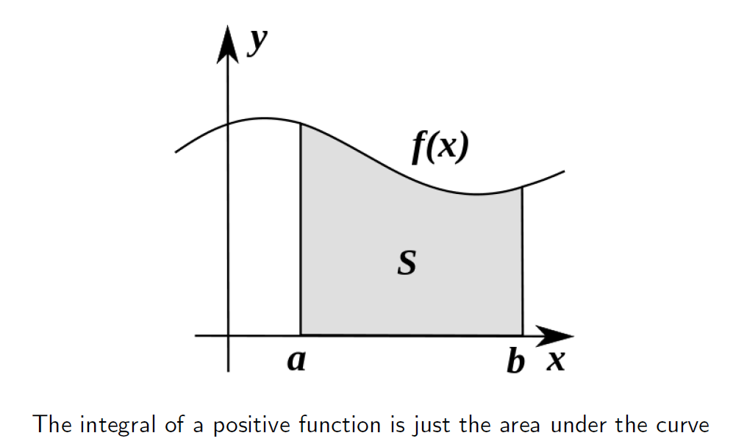
C++ – Monte Carlo Integration
We have used fact that different simulations are independent.

Slide 10
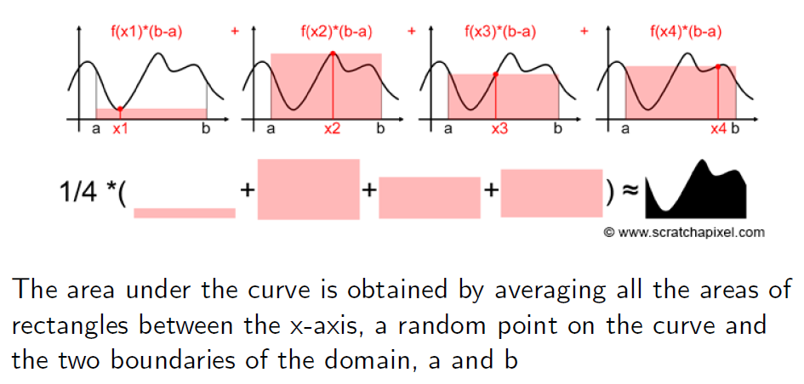
C++ – Monte Carlo Integration
We have used fact that different simulations are independent.

Slide 11
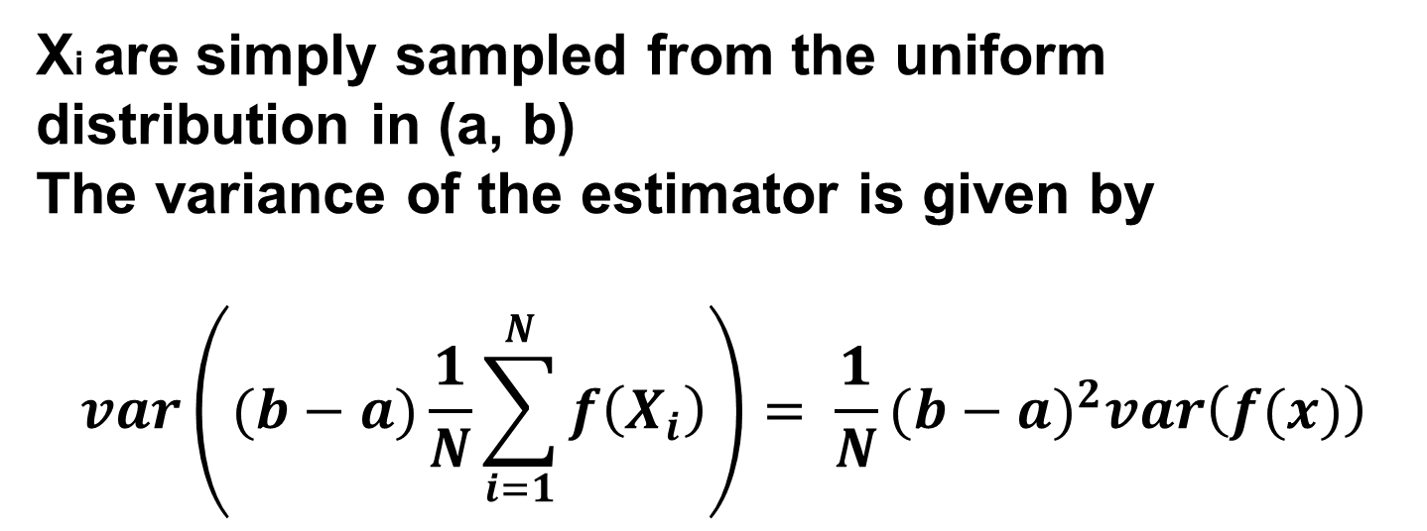
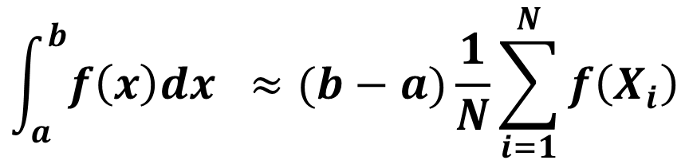
C++ – Monte Carlo Integration
$$\int_{a}^{b}{f\left(x\right)dx }≈(b−a)\frac{1}{N}\sum_{i=1}^{N}{f\left(X_{i}\right)}$$
Xi are simply sampled from the uniform distribution in (a, b)
The variance of the estimator is given by
$$var\left((b−a)\frac{1}{N}\sum_{i=1}^{N}{f\left(X_{i}\right)}\right)= \frac{1}{N}{(b−a)}^{2}var\left(f(x)\right)$$
We have used fact that different simulations are independent.

Slide 12
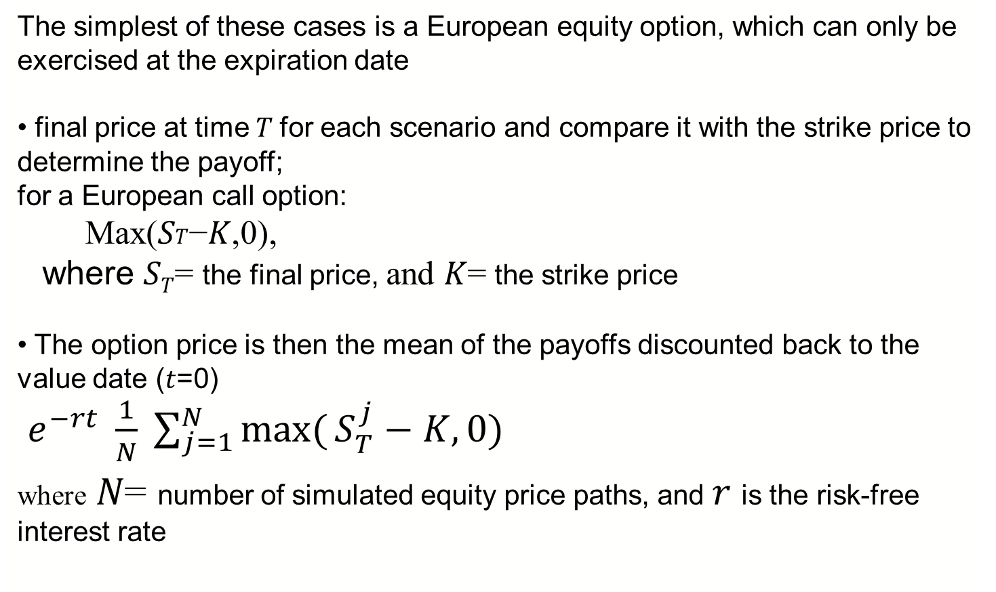
C++ – Monte Carlo Options
The simplest of these cases is a European equity option, which can only be exercised at the expiration date
• final price at time 𝑇 for each scenario and compare it with the strike price to determine the payoff;
for a European call option:
Max(𝑆𝑇−𝐾,0),
where 𝑆_{𝑇}= the final price, and 𝐾= the strike price
• The option price is then the mean of the payoffs discounted back to the value date (𝑡=0)
$e^{−rt} \frac{1}{N} \sum_{j=1}^{N}{\max_{}({S_{T}^{j}}−K,0)}$
where 𝑁= number of simulated equity price paths, and 𝑟 is the risk-free interest rate

Slide 13
C++ – Put Options
A put option provides the option buyer to sell the asset at the strike price.
Since an American option can be exercised at any time, its maximum price can be equal to its strike price.
However, for a European option, since it cannot be exercised before the expiry date, its maximum value will be equal to the present value of the strike price.

Slide 14
C++ – Call Options
A call option provides the option buyer the right to buy the asset.
For the option to have value, its price at any time must be lower than the underlying stock price at any time.
This is because if the option price were higher than the stock price, it would be cheaper to just buy the asset directly in the spot market.
Therefore, the maximum price for an option is equal to the stock price at that time.
This applies to both American and European options.

Slide 15
C++ – Options Min/Max
Type | Minimum Value | Maximum Value
European Call | c_{t} >= Max(0,S-K exp(–r(T–t))) ) | c_{t} <= S_{t}
American Call | C_{t}>= Max(0,S- K exp(–r(T–t))) | C_{t} <= S_{t}
European Put | P_{t} >= Max(0,K exp(–r(T–t))–S) | p_{t} <= K exp(–r(T–t))
American Put | P_{t} >= Max(0,K-S) | P_{t} <= K
c represents European call price (Capital C for American call) p represents European put price (Capital P for American put)
S is the Spot price
K is the Strike price
T-t is the time remaining to maturity

Slide 16
C++ – Stratified Sampling
The idea is to sub-divide the sampling domain into smaller areas for each of which a representative value of the function is selected. This can be particularly useful if a good approximation for the average over small subdomains is available.
It can be of advantage when an assessment of the total probability of a small subdomain is difficult, and each evaluation in this domain is rather cpu time expensive, but it is known that the function which is being sampled varies very little in any one given subdomain.
The segments into which the subdomain is partitioned don't have to be of equal size. A better choice of stratification is to make the subdomains have approximately equal probability associated with them.

Slide 17
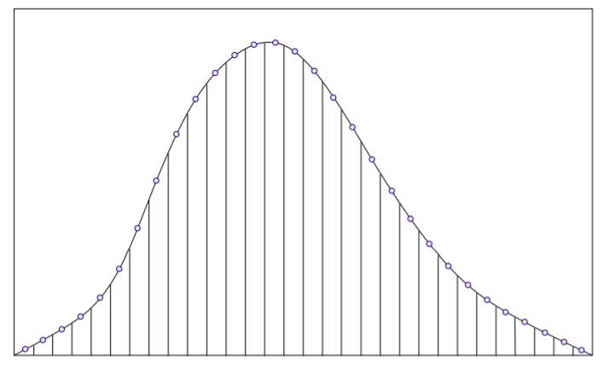
C++ – Stratified Sampling
An Example of Stratification with representative values taken at each segment

Slide 18

C++ – Monte Carlo
We have introduced Monte Carlo estimators that can price European derivatives
MC methods are intuitive in a sense that they simulate exactly the risk-neutral path of the underlying instrument (e.g. the share prices)
MC methods are also easily generalizable: even if you do not know the solution to the stochastic differential equation, you can simulate the trajectories of the underlying iteratively (for small time steps)
dS = rSdt + SdW

Slide 19
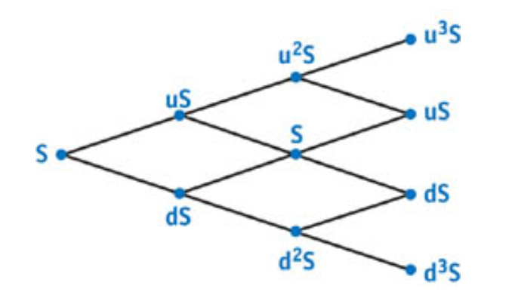
C++ – Binomial European
an option with 6 previous time steps

Slide 20
C++ – Binomial European
Computing the option value at each leaf node i is simple.
First we calculate the asset price S_{i} associated with each leaf node directly by raising u to the appropriate power (recall that d = u ⁻¹) and multiplying the result by S.
Next we compute the corresponding value of the option at each leaf, V_{i} . On the expiration date, a call option is worthless if S_{i} > X; otherwise, it has a value of X - S_{i} . The computation is similar for put options.
Using these initial values, we can then calculate the option value for each node at the previous time step.

Slide 21
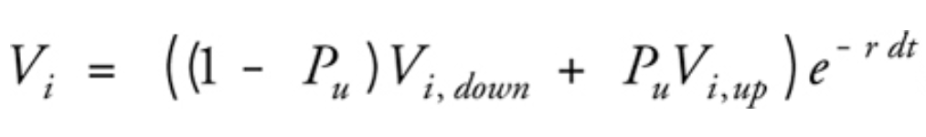
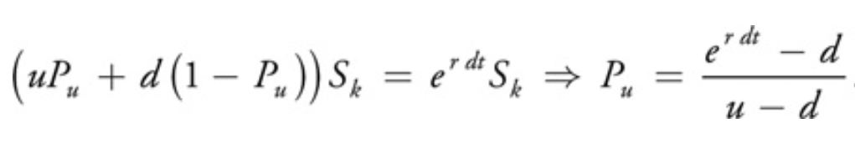
C++ – Binomial Example 1
We do so by computing the expected future value of the option using the "probability" of an upward movement, Pu, and the option values associated with the nodes in the "up" and "down" directions, V_{i,up} and V_{i,down} . We then discount this future expected value by e^{-r dt} to arrive at the option value corresponding to the node:

Slide 22
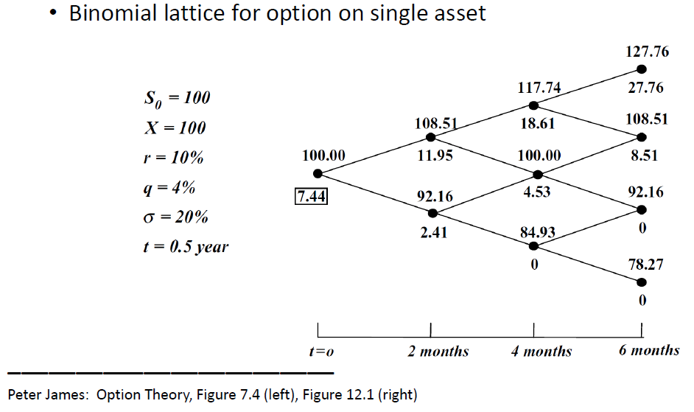
C++ – Binomial Example 1

Slide 23
C++ – Monte Carlo American
function americanPut(T, S, K, r, sigma, q, n) {
' T... expiration time
' S... stock price
' K... strike price
' q... dividend yield
' n... height of the binomial tree
deltaT := T / n;
up := exp(sigma * sqrt(deltaT));
V0 := (up*exp(-q * deltaT) - exp(-r * deltaT)) / (up^2 - 1);
V1 := exp(-r * deltaT) - V0;
' initial values at time T
for i := 0 to n {
V[i] := K - S * up^(2*i - n);
if V[i] < 0 then V[i] := 0;
}
' move to earlier times
for j := n-1 down to 0 {
for i := 0 to j {
' binomial value
V[i] := V0 * V[i+1] + V1 * V[i];
' exercise value
exercise := K - S * up^(2*i - j);
if V[i] < exercise then V[i] := exercise;
}
}
return americanPut := V[0]; }

Slide 24
C++ – Monte Carlo
However, some options including American options are not that easily price able with MC methods
For lower-dimensional processes (i.e. options depending on one or two underlying), MC methods are typically less efficient than differential equation methods
MC methods can be wasteful if many unnecessary simulations
are performed
Random number generation itself can be costly
Instead of Monte Carlo simulations, we can just solve the Black-Scholes equation directly
This is typically more efficient than Monte Carlo if the number of processes is less than 3

Slide 25
C++ – Monte Carlo
As none of the paths “care” about any of the others, this is an embarrassingly parallelizable problem
We can therefore generate each path in parallel and have no concern whatsoever for shared memory issues
Task-based parallelism using std::future and std::async is a no-nonsense and fairly straightforward solution in C++
Less error-prone
Can actually be more efficient (Meyers: Effective Modern C++)

Slide 26
C++ – Monte Carlo
void MCEuroOptPricer::computePriceAsync_(){
EquityPriceGenerator epg(spot_, numTimeSteps_, timeToExpiry_, riskFreeRate_, volatility_);
generateSeeds_();
using realVector = std::vector<double>;
std::vector<std::future<realVector> > futures;
futures.reserve(numScenarios_);
for (auto& seed : seeds_){
futures.push_back(std::async(epg, seed));
}
realVector discountedPayoffs;
discountedPayoffs.reserve(numScenarios_);
for (auto& future : futures){
double terminalPrice = future.get().back();
double payoff = payoff_(terminalPrice);
discountedPayoffs.push_back(discFactor_ * payoff);
}
double numScens = static_cast<double>(numScenarios_);
price_ = quantity_ * (1.0 / numScens) *
std::accumulate(discountedPayoffs.begin(), discountedPayoffs.end(), 0.0);
}
leveraging_modern_cpp_in_quantitative_finance__daniel_hanson__cppcon_2019.pdf

Slide 27
C++ – Monte Carlo American
As we have seen Monte Carlo simulation is a flexible and powerful numerical method to value financial derivatives of any kind.
However being a forward evolving technique, it is per se not suited to address the valuation of American or options which are valued in general by backwards induction.
Longstaff and Schwartz provide a numerically efficient method to resolve this problem by what they call Least-Squares Monte Carlo.
The problem with Monte Carlo is that the decision to exercise an American option or not is dependent on the continuation value.

Slide 28
C++ – Monte Carlo LSM
Consider a simulation with M + 1 points in time and I paths.
Given a simulated index level
S_{t,i} ,t ∈ {0,..., T}, i ∈ {1, ..., I },
what is the continuation value C_{t,i}(S_{t,i}),
i.e. the expected payoff of not exercising the option?
The approach of Longstaff-Schwartz approximates continuation values for American options in the backwards steps by an ordinary least-squares regression.
Equipped with such approximations, the option is exercised if the approximate continuation value is lower than the value of immediate exercise. Otherwise it is not exercised.

Slide 29
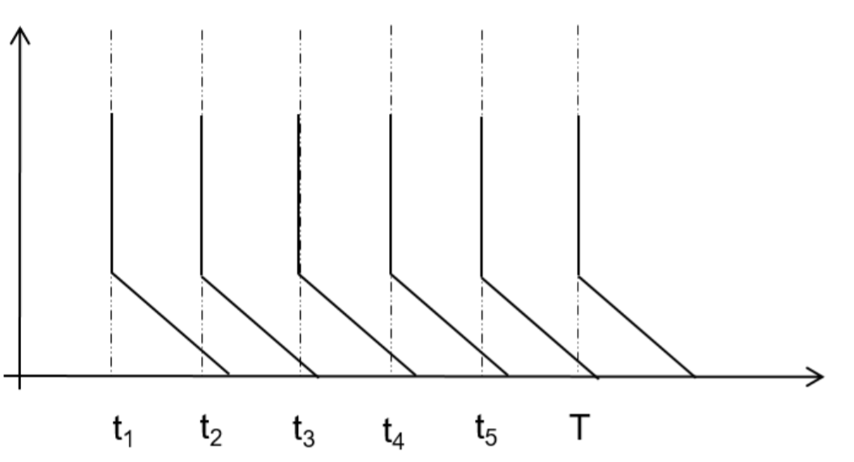
C++ – Monte Carlo American
an option with 6 time steps

Slide 30
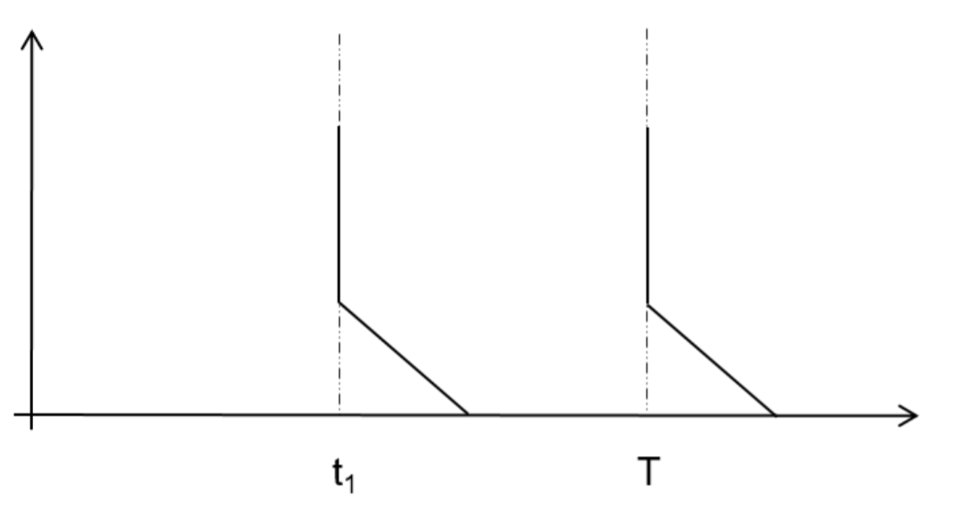
C++ – Monte Carlo American
Consider a single time step:

Slide 31
C++ – Monte Carlo American
Consider a 3-year put option where the initial asset price is 1.00, the strike price is 1.10, the risk-free rate is 6%, and there is no income.
Path | t = 0 | t = 1 | t = 2 | t = 3
1 | 1.0 | 1.09 | 1.08 | 1.34
2 | 1.0 | 1.16 | 1.26 | 1.54
3 | 1.0 | 1.22 | 1.07 | 1.03
4 | 1.0 | 0.93 | 0.97 | 0.92
5 | 1.0 | 1.11 | 1.56 | 1.52
6 | 1.0 | 0.76 | 0.77 | 0.90
7 | 1.0 | 0.92 | 0.84 | 1.01
8 | 1.0 | 0.88 | 1.22 | 1.34

Slide 32
C++ – Monte Carlo American
Our objective is to solve for the stopping rule that maximizes the value of the option at each point along each path.
Since the algorithm is recursive,
we first need to compute a number of intermediate matrices.
Conditional on not exercising the option before the final expiration date at time 3, the cash flows realized by the option holder from following the optimal strategy at time 3 are given below.

Slide 33
C++ – Monte Carlo American
3 year Option: Cash Price from 1.10
Path | t = 1 | t = 2 | t = 3
1 | - | - | 1.34
2 | - | - | 1.54
3 | - | - | 1.03
4 | - | - | 0.92
5 | - | - | 1.52
6 | - | - | 0.90
7 | - | - | 1.01
8 | - | - | 1.34
Path | t = 1 | t = 2 | t = 3
1 | - | - | 0.00
2 | - | - | 0.00
3 | - | - | 0.07
4 | - | - | 0.18
5 | - | - | 0.00
6 | - | - | 0.20
7 | - | - | 0.09
8 | - | - | 0.00

Slide 34
C++ – Monte Carlo American
Based on the previous continuation values and S, we fit a model of the form
C=a+bS+cS²
We get a best fit relation
C =-1.070+2.983 S-1.813 S²
for the continuation value C.
This defines the early exercise decision at t=2. We carry out a similar analysis at t=1.
In practice more complex functional forms can be used for the continuation value and many more paths are sampled

Slide 35
C++ – Monte Carlo American
We work back from the end using a least squares approach to calculate the continuation value at each time
Consider year 2. The option is in the money for five paths for paths 1, 3, 4, 6, 7
Let X denote the stock prices at time 2 for these five paths and Y denote the corresponding discounted cash flows received at time 3 if the put is not exercised at time 2.
These give observations on S of:
1.08, 1.07, 0.97, 0.77, 0.84
The continuation values are
0.00, 0.07e^{-0.06}, 0.18e^{-0.06}, 0.20e^{-0.06}, 0.09e^{-0.06}
https://en.wikipedia.org/wiki/Linear_regression

Slide 36
C++ – Monte Carlo American
Exercise Year 2
Cash Price from 1.10 Regression t = 2
Path | t = 1 | t = 2 | t = 3
1 | - | - | 0.00
2 | - | - | 0.00
3 | - | - | 0.07
4 | - | - | 0.18
5 | - | - | 0.00
6 | - | - | 0.20
7 | - | - | 0.09
8 | - | - | 0.00
Path | Y | X
1 | 0.94176 * 0.00 | 1.08
2 | - | -
3 | 0.94176 * 0.07 | 1.07
4 | 0.94176 * 0.18 | 0.97
5 | - | -
6 | 0.94176 * 0.20 | 0.77
7 | 0.94176 * 0.09 | 0.84
8 | - | -

Slide 37
C++ – Monte Carlo American
We work back from the end using a least squares approach to calculate the continuation value at each time
Consider year 2. The option is in the money for five paths for paths 1, 3, 4, 6, 7. These give observations on S of 1.08, 1.07, 0.97, 0.77, and 0.84.
The continuation values are 0.00, 0.07e-0.06, 0.18e-0.06, 0.20e-0.06, and 0.09e-0.06

Slide 38
C++ – Monte Carlo American
Regression t = 2
Path | Y | X | Exercise | Continuation
1 | 0.94176 * 0.00 | 1.08 | 0.02 | 0.0369
2 | - | - | - | -
3 | 0.94176 * 0.07 | 1.07 | 0.03 | 0.461
4 | 0.94176 * 0.18 | 0.97 | 0.13 | 0.1176
5 | - | - | - | -
6 | 0.94176 * 0.20 | 0.77 | 0.33 | 0.1520
7 | 0.94176 * 0.09 | 0.84 | 0.26 | 0.1565
8 | - | - | - | -

Slide 39
C++ – Monte Carlo American
Regression t = 3
Path | Y | X | Exercise | Continuation
1 | 0.94176 * 0.00 | 1.09 | 0.01 | 0.0139
2 | - | - | - | -
3 | - | - | - | -
4 | 0.94176 *0.13 | 0.93 | 0.17 | 0.1092
5 | - | - | - | -
6 | 0.94176 * 0.33 | 0.76 | 0.34 | 0.2866
7 | 0.94176 * 0.26 | 0.92 | 0.18 | 0.1175
8 | 0.94176 * 0.00 | 0.88 | 0.22 | 0.1533

Slide 40
C++ – Monte Carlo American
Final Table for Cash Flow Matrix
Path | t = 1 | t = 2 | t = 3
1 | 0.00 | 0.00 | 0.00
2 | 0.00 | 0.00 | 0.00
3 | 0.00 | 0.00 | 0.07
4 | 0.17 | 0.00 | 0.00
5 | 0.00 | 0.00 | 0.00
6 | 0.34 | 0.00 | 0.00
7 | 0.18 | 0.00 | 0.00
8 | 0.22 | 0.00 | 0.00

Slide 41
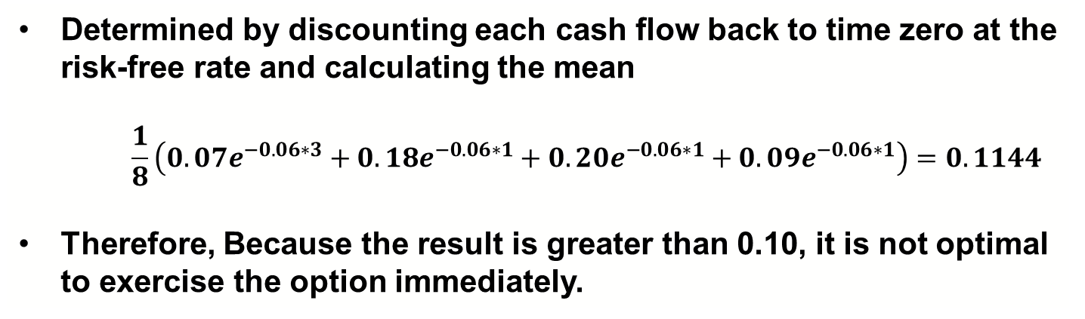
C++ – Monte Carlo American
Determined by discounting each cash flow back to time zero at the risk-free rate and calculating the mean
$$\frac{1}{8}\left(0.07e^{−0.06∗3}+0.18e^{−0.06∗1}+0.20e^{−0.06∗1}+0.09e^{−0.06∗1}\right)=0.1144$$
Therefore, Because the result is greater than 0.10, it is not optimal to exercise the option immediately.
american-option-pricing-monte-carlo-simulation

Slide 42
C++ – Monte Carlo American
function lsmc_am_put(S, K, r, σ, t, N, P)
Δt = t / N R = exp(r * Δt)
T = (S * exp(-σ^2 * Δt / 2 + σ * √Δt * 0.1) / R)
X = Array{T}(N+1, P)
for p = 1:P
X[1, p] = x = S
for n = 1:N
x *= R * exp(-σ^2 * Δt / 2 + σ * √Δt * randn())
X[n+1, p] = x
end
end
V = [max(K - x, 0) / R
for x in X[N+1, :]]
for n = N-1:-1:1
I = V .!= 0
A = [x^d for d = 0:3, x in X[n+1, :]]
β = A[:, I]' \ V[I]
cV = A' * β
for p = 1:P
ev = max(K - X[n+1, p], 0)
if I[p] && cV[p] < ev
V[p] = ev / R
else
V[p] /= R
end
end
end
return max(mean(V), K - S)

Slide 43
C++ - Black-Scholes
Black-Scholes
describes how, the value of an option changes as the price of the underlying asset changes. More precisely, it is a stochastic differential equation; it includes a random-walk term—which models the random fluctuation of the price of the underlying asset over time—in addition to a deterministic term. This random term necessitates using slightly different mathematical tools than you'd normally use to solve differential equations; see the references for details.

Slide 44

C++ - Black-Scholes
The Black-Scholes equation implies that the value of a European call option, V, may be computed as:
V = S * CND(d₁) – X e^{-rT} * CND(d₂)
Where d₁

Slide 45
C++ - Black scholes
d₂
CND is the cumulative normal distribution function, CND(x), gives the probability that a normally distributed random variable will have a value less than x. There is no closed-form expression for this function, and as such it must be evaluated numerically. It is typically approximated using a polynomial function.

